Slide 1
Introduction to pacemakers
David n pratt, md

Slide 2
Pacemakers: indications
Indication (big picture)
relieve or prevent symptomatic bradycardia not resulting from a reversible cause
asymptomatic bradycardia and serious symptoms consistent with bradycardia, but no documentation of symptomatic bradycardia, provided that alternative causes for the symptoms have been excluded.
Pacing is also indicated to prevent future symptomatic bradycardia in patients who are presently asymptomatic if the risk of rapid progression to serious symptoms is high

Slide 3
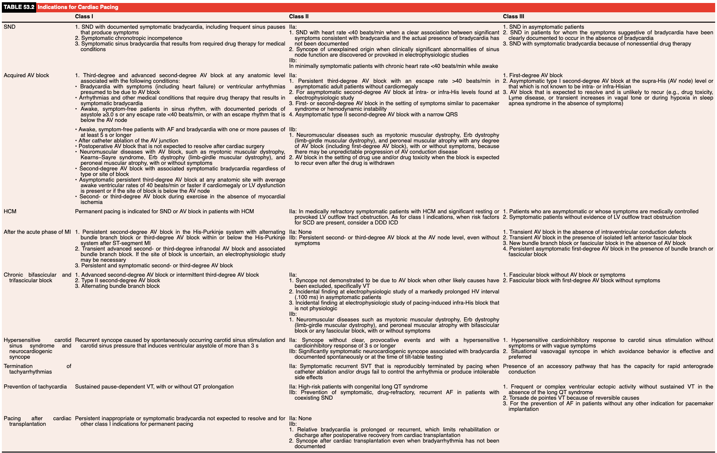

Slide 4
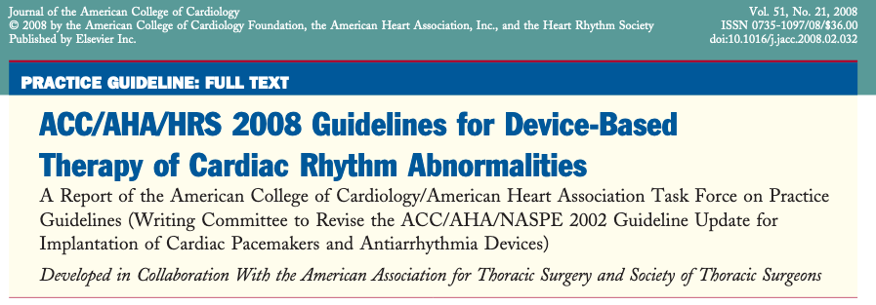
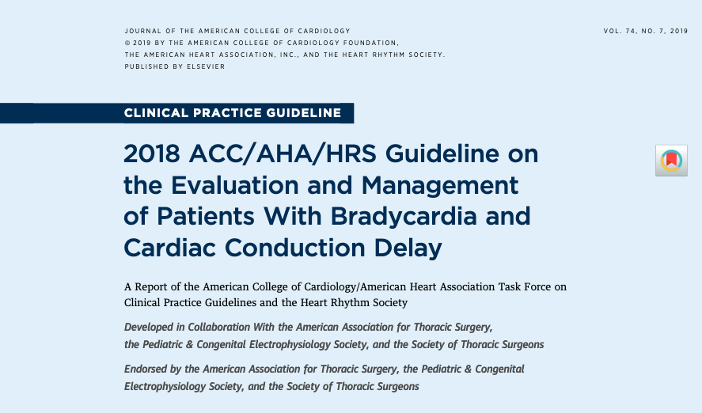
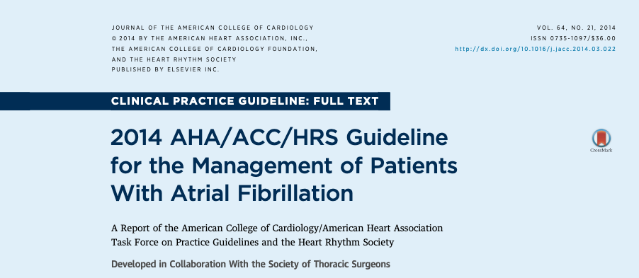
Pacemakers: societal guidelines

Slide 5
Pacemakers: societal guidelines
Point being – cardiologists like trials and guidelines, to our own demise
Confusing, overlapping, and not one single document

Slide 6
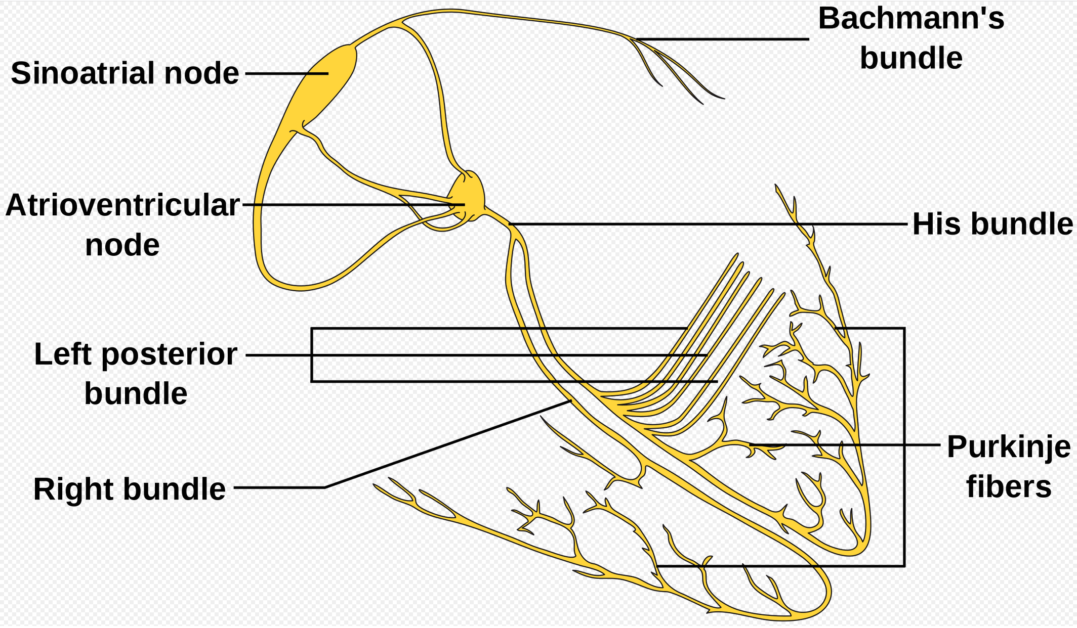
Normal intracardiac conduction

Slide 7
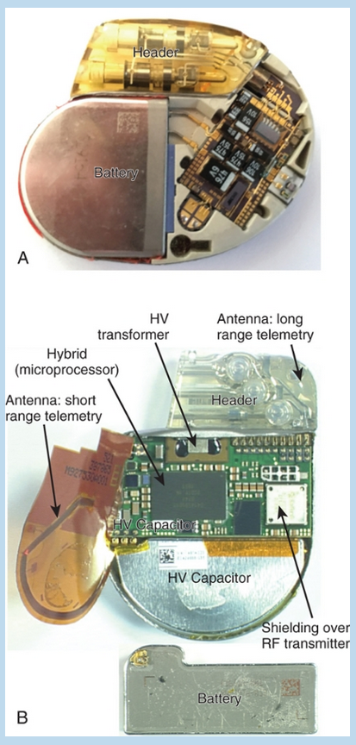
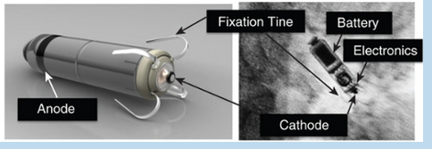
Pacemakers: components
Leads
Small, distal tip electrode for pacing and sensing
Fixation mechanism to anchor the lead to heart
Proximal terminal connected to the generator
Unipolar and bipolar leads: do not worry about this
Generators
Header: plastic component where leads attach
”Can”: (titanium casing): houses the battery, tiny capacitors for pacing, and circuitry
“leadless pacemakers”: new technology, capsule with both generator and “lead”

Slide 8
Principles of pacing
Pacemakers sense intracardiac electrical signals (electrograms) and deliver low-voltage electrical stimuli (pulses) when the intrinsic cardiac rate is too slow
Cardiac electrical stimulation (aka pacing)
sensing

Slide 9
Principles of pacing
Cardiac electrical stimulation (aka pacing)
Local stimulus creating a field sufficient to depolarize (aka reduce the membrane potential of) local myocardium during diastole to initiate a self-propagating wavefront of depolarization
Success = “capture”
Two components: energy delivered and duration of energy delivery
Bipolar vs unipolar pacing
Tip of lead is the cathode, anode is either ring electrode on lead (bipolar) or housed in the pacemaker generator (unipolar)

Slide 10
Principles of pacing
Electrograms and pacemaker sensing
electrogram (EGM) displays the electrical potential difference between two points in space as a function of time
Picks up the electrical activity at the tip of the lead/electrode
What is the problem with this model?

Slide 11
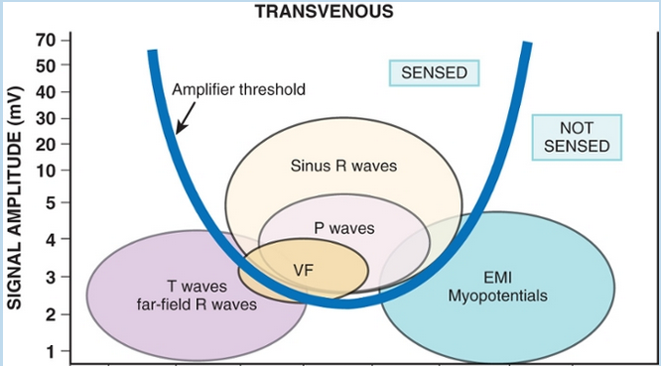
Principles of pacing
What is the problem with this model?
More than just the area of the heart being sensed has electrical current!

Slide 12
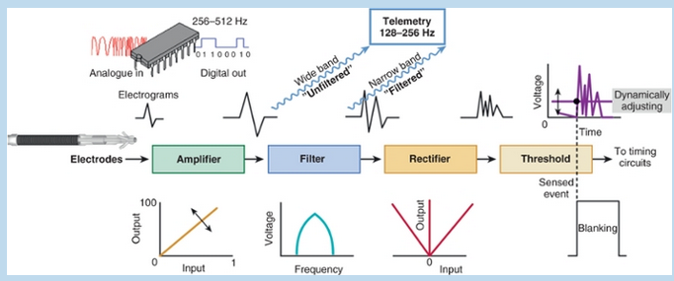
Principles of pacing
Wave front passes electrode → EGM travels from lead tip to generator → Amplification → filtered →
processed by sensing electronics → Compared to threshold voltage (sensing threshold)
If sensed event exceeds the sensing threshold, the device with interpret at an atrial (or ventricular) depolarization

Slide 13
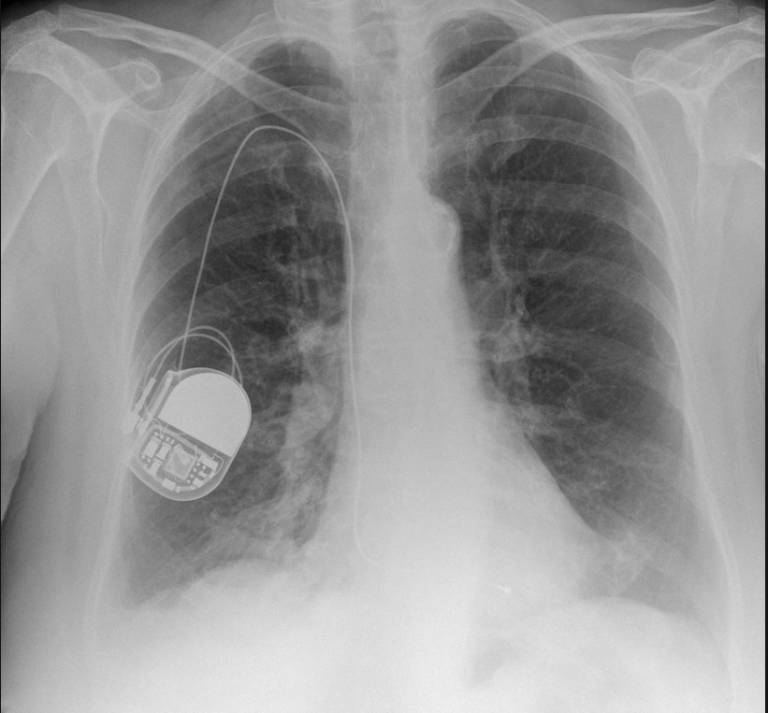
Chest Radiograph

Slide 14
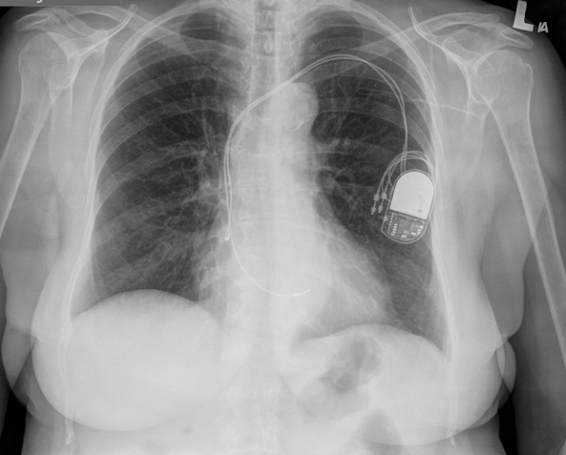
Chest Radiograph

Slide 15
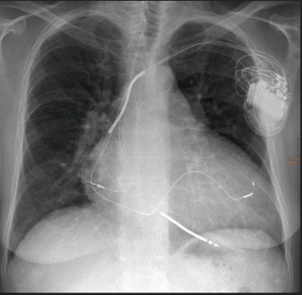
Chest Radiograph

Slide 16
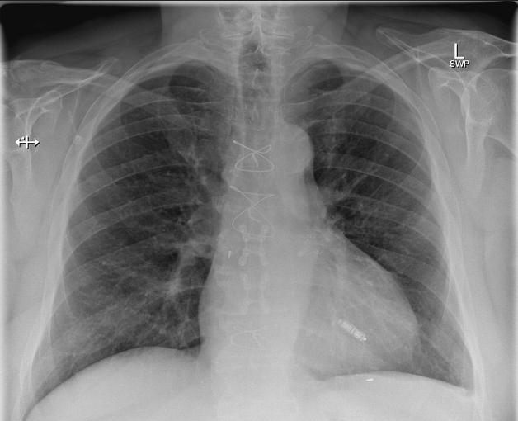
Chest Radiograph

Slide 17
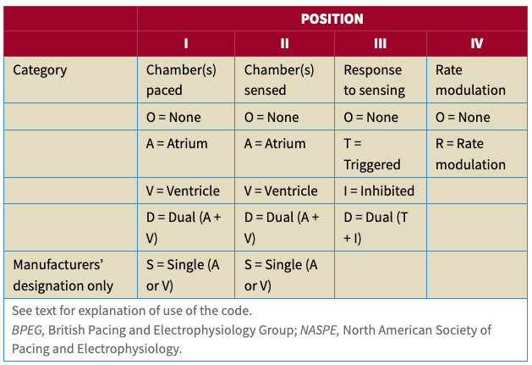
Pacemaker Mode and Timing Cycles
Describe which chamber is sensed, paced and response to sensed rhythm
Four (five)-letter code
Position #1: chamber paced
Position #2: chamber sensed
Position #3: response to sensed rhythm
Position #4: rate modulation
Position #5: rarely used, indicative of multisite pacing

Slide 18
Physiologic pacing
pacing systems that approximate normal cardiac behavior
Maintain av synchrony
Biventricular pacing
Rate responsiveness
Benefits
Reduced incidence of atrial tachyarrhythmias (including AF)
Less thromboembolic events (due to less AF)
Improved hemodynamics (atrial kick ~20% of ventricular filling)

Slide 19
pacing modes
Single Chamber pacing: one lead (atrial or ventricular)
Examples: vvi/vvir, aai/aair
Dual chamber pacing: two or more leads (atrial and ventricular)
Examples: ddd/dddr, ddi/ddir, vdd, dvi
Asynchronous pacing
Examples: aoo, voo, doo

Slide 20
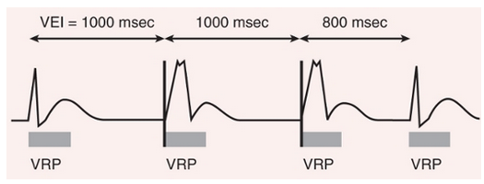
Single chamber pacing: vvi/VVIR
Vvi: “ventricular demand pacing”
Ventricular paced, ventricular sensed, pacemaker inhibited in response to a sensed beat
Very simple mode, used predominantly for single chamber ventricular pacing
Set a “lower rate limit” or “ventricular escape interval” and a “ventricular refractory period”
Advantages: Single lead, easy to insert (ex Transvenous pacemakers)
Disadvantages: No atrial sensing → no AV synchrony
Ideal patients: Permanent Atrial fibrillation or other patients where AV synchrony is not needed or unable to be achieved
Notes:
The VVI timing cycle consists of a defined lower rate limit and a ventricular refractory period (VRP, represented by rectangles). When the ventricular escape interval (VEI) from the ventricular sensed event of 1000 milliseconds is completed, a paced event occurs. Because no ventricular sensed event occurs within 1000 milliseconds after the paced event, a second ventricular paced event occurs. Because a ventricular sensed event occurs 800 milliseconds later, a ventricular paced event does not occur. A VRP begins with any sensed or paced ventricular activity.

Slide 21
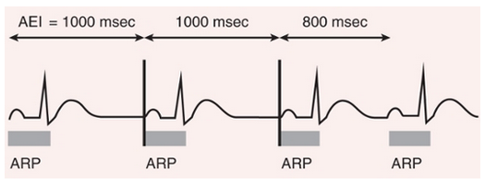
Single chamber pacing: AAI/AAIR
AAi: “Atrial Demand pacing”
atrium paced, atrium sensed, pacemaker inhibited in response to sensed atrial beat
Very simple mode, used predominantly for single chamber atrial pacing
Common in Europe, not common in the united states
Settings: “lower rate limit” and atrial refractory period
Advantages: single lead, Maintain av synchrony
Disadvantages: no protection from ventricular bradycardia 2/2 AV node conduction disease
Not a good option for patients with AV node disease / AV block
Ideal patients: Sinus node dysfunction, symptomatic sinus bradycardia, or sinus pauses
Must have a healthy AV node (no AV block)
Ideally able to accelerate their heart rate with exertion, otherwise will need AAIR
Notes:
The AAI timing cycle consists of a defined lower rate limit and an atrial refractory period (ARP, represented by rectangles). When the atrial escape interval (AEI) from the atrial sensed event of 1000 milliseconds is completed, a paced event occurs. Because no atrial sensed event occurs within 1000 milliseconds after the paced event, a second atrial paced event occurs. Because an atrial sensed event occurs 800 milliseconds later, an atrial paced event does not occur. An ARP begins with any sensed or paced atrial activity.

Slide 22
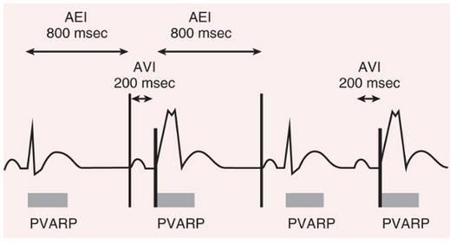
Dual chamber pacing: DDD/DDDR
DDD: sensing and pacing capabilities in both the atrium and the ventricle
Very common pacing mode for dual chamber pacemakers (atrial lead and ventricular lead)
Scenarios
Sinus rhythm (faster than set lower limit rate) with normal AV conduction: totally inhibited
Sinus bradycardia (slower than set lower limit rate) with normal av conduction: atrial paced, ventricular sensed
Sinus bradycardia (slower than set lower limit rate) with delayed AV conduction (below set AV interval) → atrial paced, ventricular paced
Sinus rhythm with delayed av conduction (conduction (below set AV interval) → atrial sensed, ventricular paced
Advantages: physiologic pacing (maintain av synchrony)
Ideal Patient: AV block who have normal sinus node function, combined sinus nodal and AV nodal dysfunction
Potential problems
Atrial tachyarrhythmias (AF, AFL, SVT, AT, etc)
Notes:
The timing cycle in DDD consists of a lower rate limit, an AV interval, a ventricular refractory period (not shown), a postventricular atrial refractory period (PVARP), and an upper rate limit. Because an intrinsic atrial event occurs and is followed by an intrinsic ventricular event within the AV interval, no ventricular pacing occurs in the first beat. In ventricular-based timing, the time from a ventricular paced or sensed event to the next atrial paced event is called the atrial escape interval (AEI), which is the lower rate limit interval minus the AV interval. Because no intrinsic atrial event occurs before the AEI times out, a paced atrial event occurs in the second beat. Since no intrinsic ventricular event occurs within the AV interval after this atrial paced event, a ventricular paced event occurs. Following this ventricular paced event an atrial paced event is delivered when the AEI times out 800 milliseconds later to initiate the third beat. Since AV conduction follows this atrial paced event, ventricular pacing is inhibited. The fourth beat begins with an intrinsic atrial event that is not followed by an intrinsic ventricular event within the AV interval. Hence the intrinsic atrial event is “tracked” and followed by a paced ventricular event.
The DDD pacing mode is appropriate for patients with AV block who have normal sinus node function. DDD pacing is also considered by some to be the mode of choice in carotid sinus hypersensitivity with symptomatic cardioinhibition. However, most patients should receive a pacemaker capable of DDDR pacing, even if rate response is not initially programmed "on."
The ideal patient for DDDR pacing is one with combined sinus nodal and AV nodal dysfunction in whom DDDR pacing would restore rate responsiveness and AV synchrony. DDDR pacing is also appropriate for patients with SND and normal AV conduction. As noted above, many practitioners are not comfortable with AAIR pacing. Use of DDDR pacing mode with an algorithm that will minimize ventricular pacing is often preferred.

Slide 23
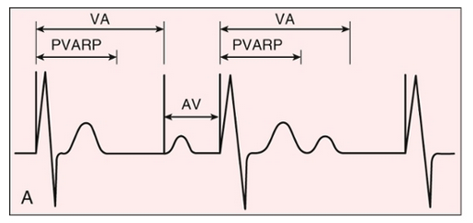
Dual Chamber Pacing: DDI/DDIR
DDI: atrial sensing and pacing, and ventricular sensing and pacing; however, the pacemaker will not track intrinsic atrial activity
When there is a sensed native atrial rate, the pacemaker will inhibit both atrial and ventricular output, thereby allowing native conduction to the ventricle.
If AV block develops, ventricular pacing will occur at a programmed rate, but will not be synchronized with the atrium.
Example: DDI with lower limit 50 bpm
Sinus rhythm at 60 bpm: fully inhibited
Sinus rhythm at 60 bpm but 2:1 AV block → V-paced at 50 bpm irrespective of atrial activity (no AV synchrony)
Sinus bradycardia at 40 bpm: pacemaker will pace the atrium and ventricle synchronously at 50 beats per minute.
Benefit: no atrial tracking, so atrial tachyarrhythmias are not V-paced
Ideal patient: sinus bradycardia with or without av node disease
Notes:
As an example, if a device is programmed DDI at 50 beats per minute, and the patient has sinus rhythm at 60 with 1:1 AV conduction, the device will be fully inhibited. If AV block develops, the pacemaker will pace the ventricle at 50 beats per minute. If sinus bradycardia develops, the pacemaker will pace the atrium and ventricle synchronously at 50 beats per minute.
In the DDI mode, if the sinus rate is below the programmed rate, the pacemaker will pace the atrium and ventricle sequentially.
There are few, if any, advantages of DDI or DDIR pacing at this time. At one time, this mode was helpful for the patient with atrial tachyarrhythmias. Since DDI does not "track," this mode would alleviate the concern of fast ventricular rates in response to the atrial tachyarrhythmia.
However, this has become much less important since essentially all dual-chamber devices now have mode switching capability. (See 'Mode switching' above.)

Slide 24
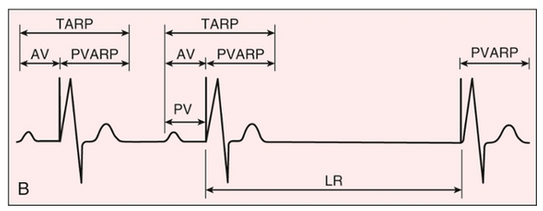
Dual Chamber Pacing: VDD
vdd: ventricle paced, atrium and ventricle sensed, and either inhibition or tracking of the pacemaker in response to a sensed beat
Lacks atrial pacing
Ideal patient: normal sinus node function and diseased av node
Not commonly used now due to ddd pacing
Not-ideal patient: sinus bradycardia → v pacing at lower limit
Benefit: can be achieved with one lead (atrial sensing electrode on a ventricular pacing lead)
Allows atrial tracking to maintain av synchrony
Notes:
However, a single-lead VDD pacing system, now available for many years, has increased interest in the use of VDD as the initial pacing mode in patients with AV block but normal sinus node function [11-13]. In these systems, atrial sensing is accomplished from "floating" sensing electrodes on the atrial portion of the ventricular pacing lead.
One limitation to the use of a single-lead VDD pacemaker is that patients with initially normal SA node function may develop SND. This would then require a second procedure to place an atrial lead capable of pacing in order to maintain AV synchrony and chronotropic competence. However, this is an infrequent occurrence [14,15].

Slide 25
Dual Chamber Pacing: dvi
DVI Pacing: atrium and ventricle paced, ventricular sensing only, and inhibition of pacemaker in response to sensed ventricular beat
Not common, mostly of historical interest only
Lacks atrial sensing comes with consequences
cannot maintain rate responsiveness in chronotropically competent patients
Can lead to competitive atrial pacing and initiate atrial tachyarrhythmias

Slide 26
Asynchronous pacing modes
Aoo, voo, doo
atrium, ventricle, or both are paced, but the pacemaker has no sensing capability and hence there is no sensing response of the pacemaker.
Not good long term use, can be helpful in pacemaker dependent patients in the or
Electrocautery can interfere with sensing
Potential problems: competition between the native and the paced rhythms
P on T Phenomenon: paced impulse during a native T wave (vulnerable period).
asynchronous pacing could be programmed to a relatively higher rate than native rate

Slide 27
Biventricular pacing
Ventricular dyssynchrony is bad
Can occur from native conduction (LBBB, RBBB) or iatrogenic from chronic ventricular pacing
“Cardiac Resynchronization” – Restoration of ventricular synchrony
Third lead placed into coronary sinus → LV pacing coordinated with RV pacing
Multiple trials showing benefit in Heart failure with NYHA II-IV symptoms

Slide 28
Problem #1
A patient with sinus node dysfunction with AAI programming (Lower rate 50 bpm) is feeling cooped up because he obeyed dr amy acton and has been #stayinghome, but decided today is the day he is going for a run.
He drives to eden park, has a beautiful view, starts running, and about ½ mile in…. He collapses!
Why did this happen???
Notes:
Rate responsiveness — As described above, rate responsiveness, also referred to as rate modulation or rate adaptation, refers to the ability of a pacemaker to adjust its programmed paced rate based upon patient activity. A variety of sensors have been designed to determine when a patient is physically active (eg, vibration, minute ventilation, change in right ventricular impedance). The range of heart rates, the pace of acceleration and deceleration, and the degree of activity required to initiate this response are all programmable in rate-adaptive pacing modes.

Slide 29
Rate modulation
Chronotropic response and rate-adaptive pacing
Remember that fourth position in nomenclature?
Rate Modulation / Rate adaptation
Pacemaker ability to adjust its programmed paced rate based on patient activity
Vibration, minute ventilation, right ventricular impedance
Example: back up rate 50 bpm with rest, back up rate 80 bpm with exercise
Notes:
Rate responsiveness — As described above, rate responsiveness, also referred to as rate modulation or rate adaptation, refers to the ability of a pacemaker to adjust its programmed paced rate based upon patient activity. A variety of sensors have been designed to determine when a patient is physically active (eg, vibration, minute ventilation, change in right ventricular impedance). The range of heart rates, the pace of acceleration and deceleration, and the degree of activity required to initiate this response are all programmable in rate-adaptive pacing modes.

Slide 30
Problem #2
Atrial fibrillation, atrial flutter, and SVT are problematic for many patients with pacemakers
Scenario: Paroxysmal atrial fibrillation in a patient with DDD pacing
NSR → Atrial fibrillation: atrial sensed rate is now 350-450 bpM
Questions
What normally happens in atrial fibrillation?
Why doesn’t your ventricular rate get to the same rate as the atrial rate?

Slide 31
Mode Switching
In dual pacing, the ventricle will be paced for every sensed atrial beat
Atrial fibrillation (atrial rate 350-450 bpm) → ventricular pacing 1:1
That’s bad!
Mode Switching: automatic re-programmingto stop atrial tracking
Examples: VVI, DDI, DVI
DDD → VVI when atrial rate is above 120 bpm
When atrial rate drops below the set rate (example: AF → NSR) → switch back VVI to DDD

Slide 32
Problem #3
60 year old male underwent single chamber pacemaker 5 years ago for intermittent second degree AV block
Vvi pacing
Interrogation shortly after implantation showed 5% pacing
Presented to clinic with fatigue, dizziness, and throat fullness
Exam: cannon A waves, rales, and holosystolic murmur at apex
Interrogation shows 99% V paced burden
Notes:
general malaise, easy fatigability, dyspnea, orthopnea, cough, dizziness, atypical chest discomfort, and a sensation of throat fullness and, less commonly, may result in pre-syncope or syncope. Physical examination may reveal hypotension, rales, increased jugular venous pressure with cannon A waves, peripheral edema, and murmurs of tricuspid and/or mitral regurgitation

Slide 33
Pacemaker Syndrome
Phenomenon associated with AV dyssynchrony
Result of the adverse hemodynamics associated with a normally functioning pacing system
Results in a limitation in the ability to achieve optimal functional status
Symptoms: non-specific, include malaise, fatigue, dyspnea, orthopnea, cough, dizziness, atypical chest discomfort, throat fullness and sometimes pre-syncope or syncope
Examination: hypotension, rales, increased jugular venous pressure with cannon A waves, peripheral edema, and murmurs of tricuspid and/or mitral regurgitation
Treatment: may require upgrade to more physiologic pacing (dual chamber or biventricular pacing)

Slide 34
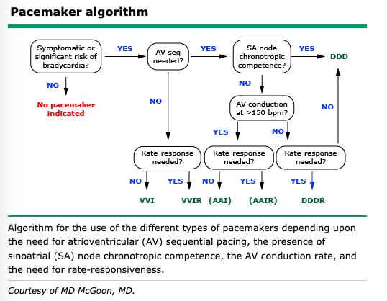
Choosing the right ppm

Slide 35
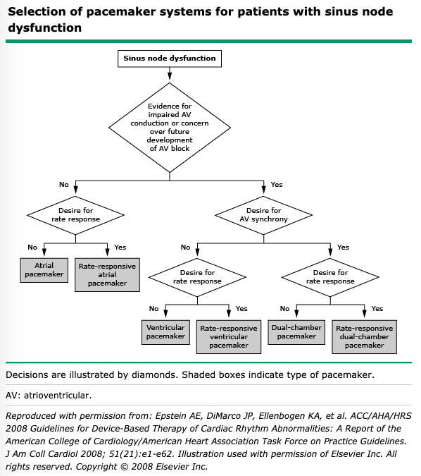
Sinus node disease

Slide 36
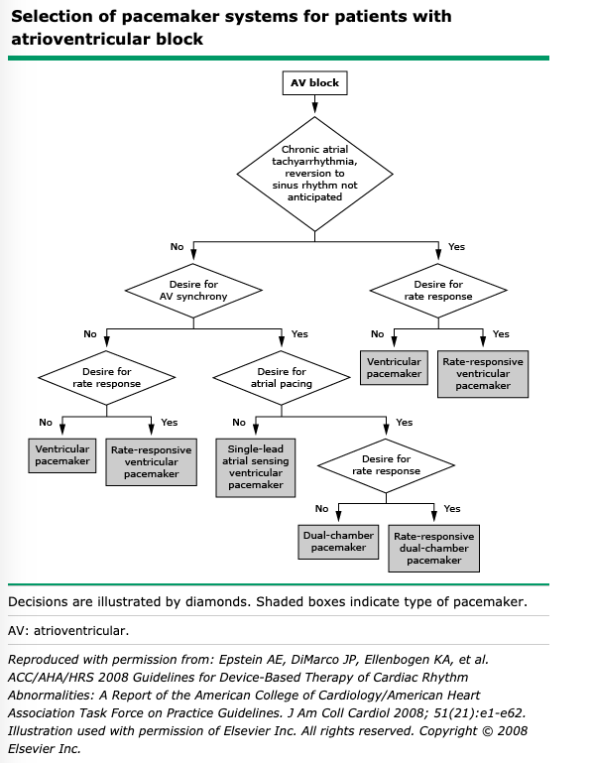
AV Node Disease

Slide 37
Questions?

