Slide 1
Basics of Lung Ultrasound
Jessica Baez, MD
University of Cincinnati

Slide 2
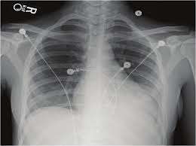
Notes:
Why should you care about lung US? I don’t know about you guys, but in the pre-COVID era, we could get a stat CXR within 5 minutes of a patient’s arrival if we really needed it…and it can definitely tell you a lot of important information super quickly.

Slide 3
Impression: Bibasilar opacities; atelectasis versus pneumonia. Clinical correlation recommended.
Notes:
How often though are you getting a read like this? Or even on your own interpretation, how often are you unsure whether something is pneumonia or edema or maybe effusion? Sometimes it can be pretty difficult to tell.

Slide 4
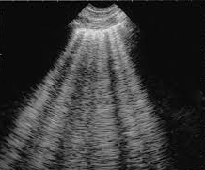
Notes:
This is where lung ultrasound has the advantage and can actually give you a ton of information.

Slide 5
POCUS

Slide 6
Utility of Lung Ultrasound
Pneumothorax
Consolidation
Pulmonary edema
Pleural effusion
Notes:
Answering a yes or no question…important to know your limitations.

Slide 7
Meta-analysis
CXR: 52% sensitive, 100% specific
US: 88% sensitive, 99% specific
Notes:
Pooled sensitivities of US better than AP CXR for diagnosis of PTX.

Slide 8
US: higher sensitivity and diagnostic accuracy
Pleural effusions
PNA
Pulmonary edema
Notes:
This was a prospective study, only 32 patients, but they looked at the diagnostic accuracy of lung auscultation, CXR, and lung ultrasound in ARDS.
This was also replicated n 2011 and held true.

Slide 9
Notes:
Why should you guys as IM residents learn about this?

Slide 10
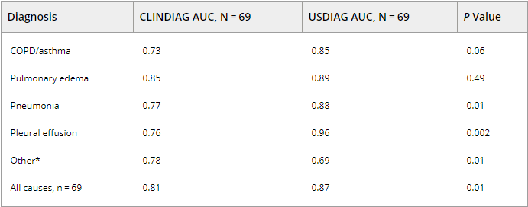
Notes:
Prospective study where IM residents were given a handheld US…Focused training for 90 minutes x 2, extended training for 2 week elective with hands-on guidance.
Asked diagnosis before and after POCUS and looked at how well that agreed with final diagnosis as determined by the attending who was blinded to US results.

Slide 11
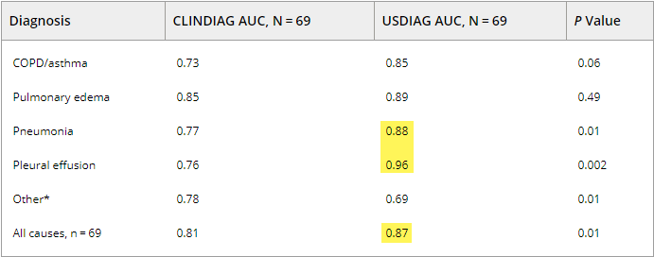
Notes:
Statistically significant improvement in diagnostic accuracy for dx of PNA, pleural effusion, and all causes together based on area under the curve.

Slide 12
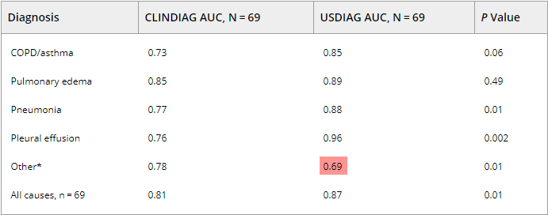
Notes:
Notably, decreased accuracy in the other causes: Other: anemia, ascites, dehydration.
…cannot totally supplant physical exam. Use as an adjunct to improve accuracy, but clinical presentation still important.

Slide 13
Notes:
Has been shown in heart failure patients to predict patients at risk for readmission within 6 months based on amount of pulmonary edema on US.

Slide 14
Notes:
Many studies suggesting that lung US has a role for COVID patients for many reasons. Some suggest it can help triage pts according to who is unlikely to become hypoxic and is therefore safe for discharge, some studies suggest it may have a prognostic benefit, may be able to help identify pts who will benefit from proning.

Slide 16
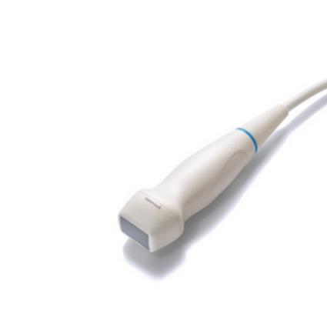
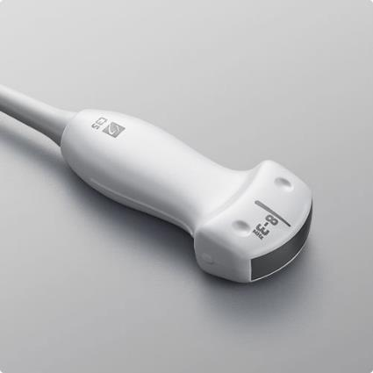
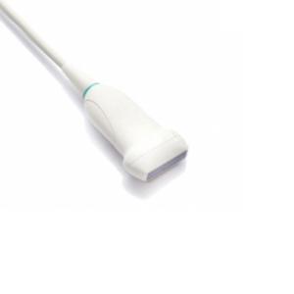

Slide 17
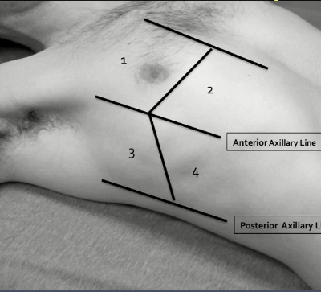
Technique
Notes:
There are a bunch of different proposed algorithms on where you should go for lung ultrasound and how many areas you should be scanning. Some people say you should look at 6 points on each side for a total of 12 points for lung US, many people say 5 points per side. This particular picture is part of a 8 lung zone protocol developed by Volpicelli.
Ultimately, the more the better because it gives you more info about the lungs, but I would say 2-3 anteriorly, 2 laterally, and 1 posteriorly if you can is a good approach.

Slide 18
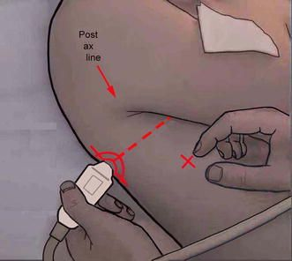
Technique
Notes:
PLAPS point: very high yield for finding effusion, local B lines, many pneumonias will accumulate here because it is a dependent area.
Nipple line to posterior axillary line.

Slide 19
Notes:
Bat wing sign with rib shadows and pleural line.

Slide 20
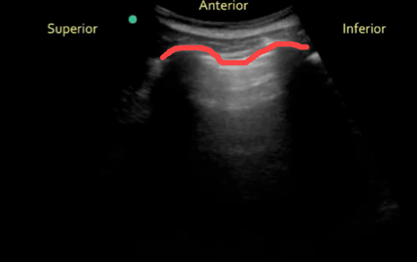

Slide 21
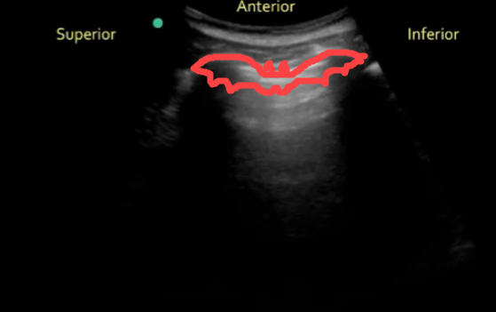

Slide 22
Notes:
Think of yourself as Indiana Jones…

Slide 23
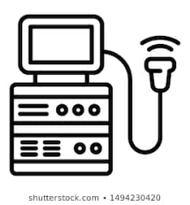
Notes:
…because lung ultrasound is all about looking for artifacts.

Slide 24
Notes:
It’s actually a bit of an alphabet soup in terms of the names of those artifacts.

Slide 25
A Lines
Notes:
Note these horizontal lines here, the A lines. These are normal and due to reverberation artifact. This occurs when 2 or more strong acoustic reflectors are encountered and the beam repeatedly reflects back and forth between the two reflectors. Occurs when no fluid in the tissue- normal.

Slide 26
B Lines
Notes:
B lines, these vertical hyperechoic lines that kind of look like flashlights shining down. These represent fluid within the pulmonary tissue.
Both lungs with 3 or more B lines is 85% sensitive and 97% specific for alveolar insterstitial syndrome-

Slide 27
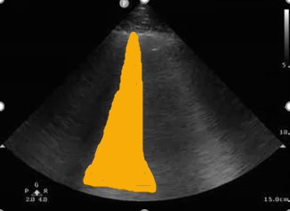
B Lines

Slide 28
Z Lines
Notes:
These are Z lines, another normal artifact. Sometimes called comet tail artifact, but note that these vertical lines are short and do not extend across the whole screen. These are normal artifacts- A and Z lines.

Slide 29
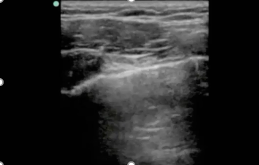
Z Lines
Notes:
These are Z lines, another normal artifact. Sometimes called comet tail artifact, but note that these vertical lines are short and do not extend across the whole screen. These are normal artifacts- A and Z lines.

Slide 30
Pathology

Slide 31
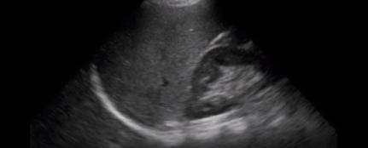
Pleural Effusion
Notes:
When evaluating for a pleural effusion, find a RUQ or LUQ FAST view or PLAPS point.
2/3 of the time, PNA is accompanied with a pleural effusion.

Slide 32
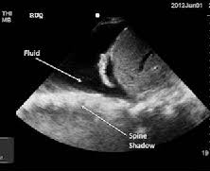
Spine Sign
Notes:
The first thing you are looking for is the spine sign. So in the presence of a pleural effusion, the US beams can actually be conducted through the thorax (normally they can’t cuz the air-filled lung is there. So then you can see the spine when normally you cannot.

Slide 33
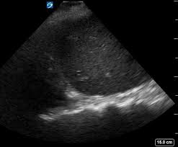
Spine Sign
Notes:
Here is a little more subtle example.

Slide 34
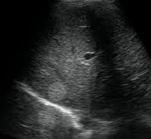
Mirror Sign
Notes:
Mirror image artifact. The machine thinks that all US beams travel in a straight line and because of a lot of fancy physics, a mirror image can occur and look like a second liver or spleen above the diaphragm. This only occurs when there is air in the lungs here, so no pleural effusion.
Echogenic liver lesion

Slide 35
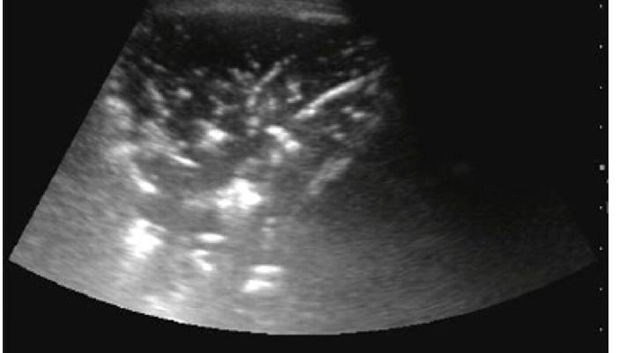
Pneumonia
Notes:
So this is where you are going to look anteriorly and laterally, with the most sensitive area being the right inferior lung field.

Slide 36
Notes:
Bat wing sign with rib shadows and pleural line.

Slide 37
Sub-Pleural Consolidation
Notes:
The presence of this with surrounding B lines in the right clinical context is concerning for PNA.

Slide 38
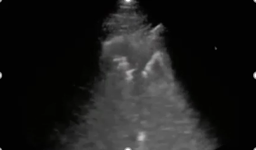
Shred Sign

Slide 39
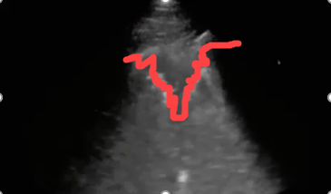
Shred Sign

Slide 40
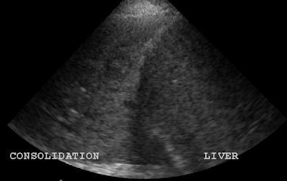
Hepatization of the Lung

Slide 41
Bronchograms
Air
Fluid

Slide 42
Air Bronchograms
Static
Dynamic
Notes:
Most specific for pneumonia. Basically, you are seeing air filled bronchi surrounding and highlighted by fluid-filled alveolar tissue.
Dynamic only seen in PNA, static can be seen in atelectasis as well.

Slide 43
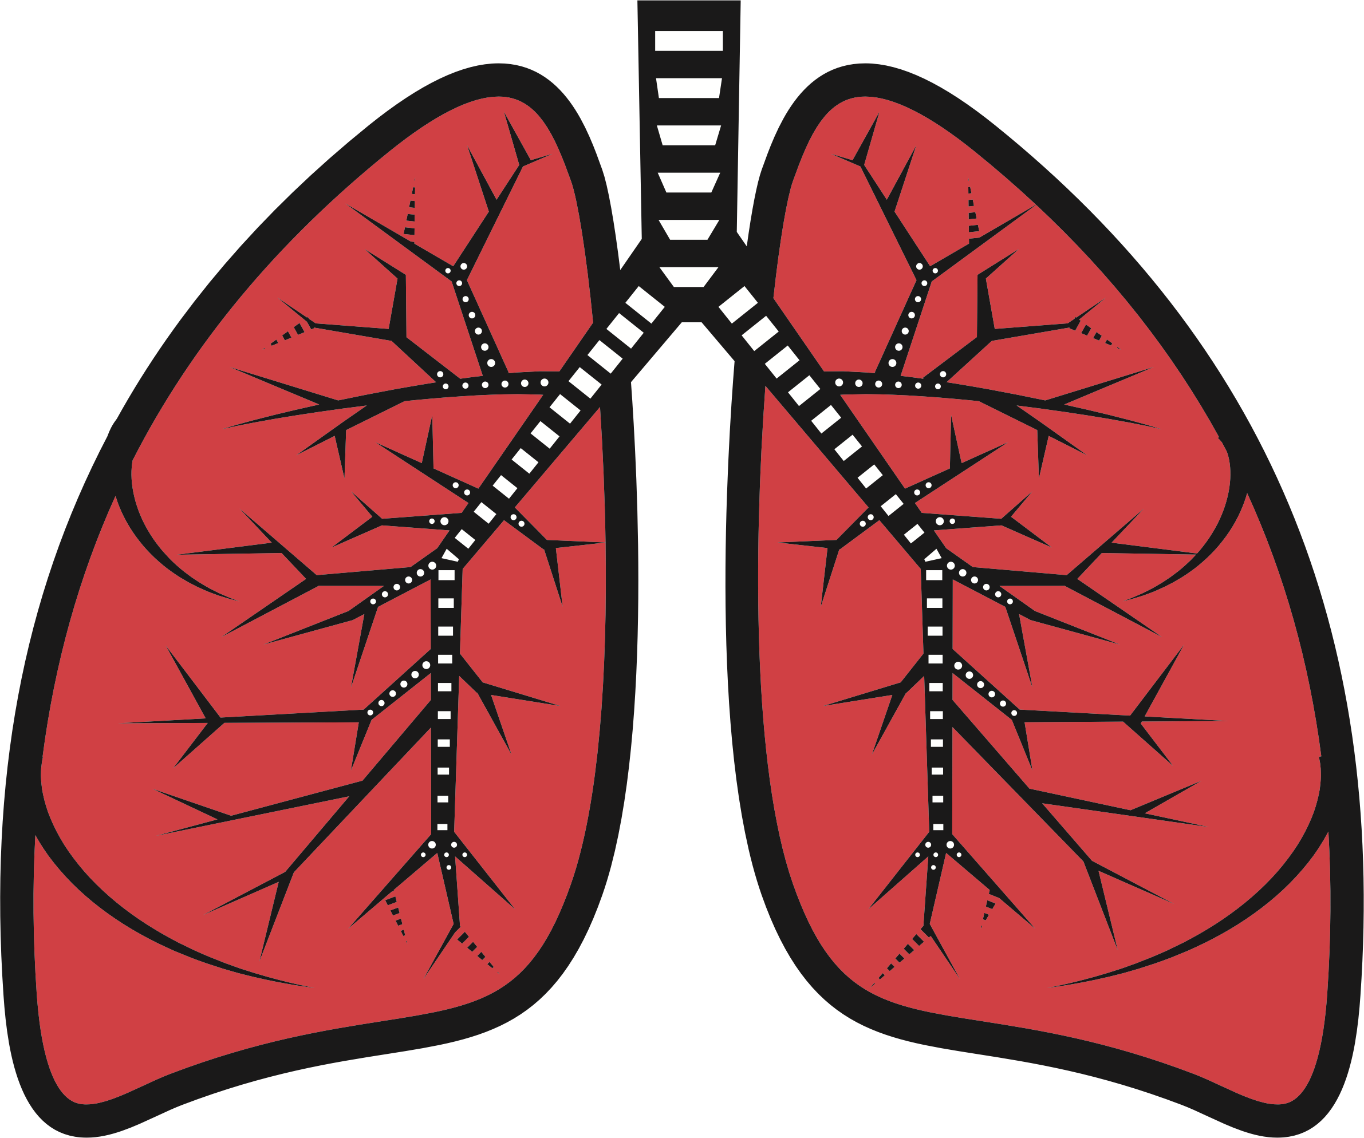

Slide 45
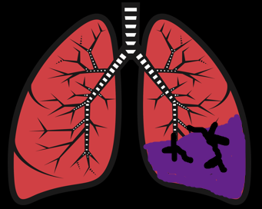

Slide 46
Fluid Bronchogram

Slide 47
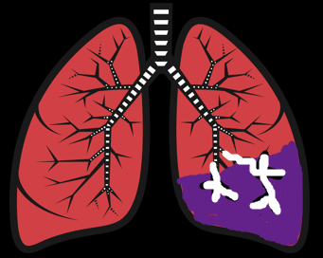
Air Bronchogram

Slide 48
Static Air Bronchogram

Slide 49
Dynamic Air Bronchograms
Notes:
These are very specific for PNA.
Of note, you are also seeing hepatization of the long as well here. Basically meaning the lung looks like the liver.

Slide 50
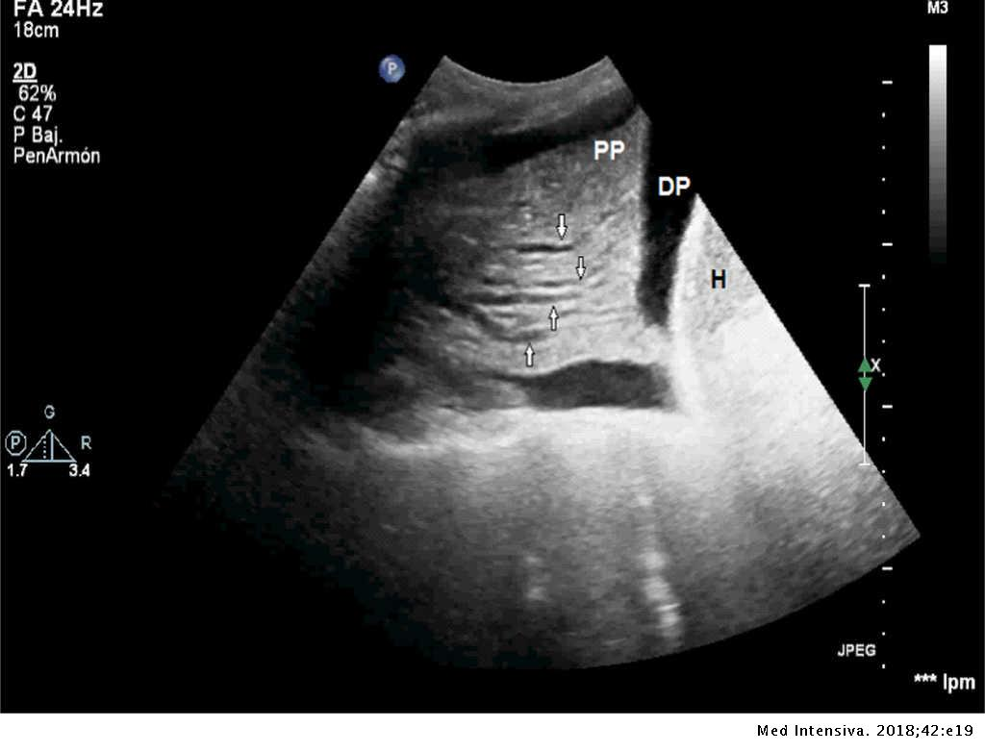
Fluid Bronchograms
Notes:
This is usually a progression of air bronchograms and occurs when fluid fills the bronchi. You’ll see these anechoic areas within the lung parenchyma. Also fairly specific for PNA.

Slide 51
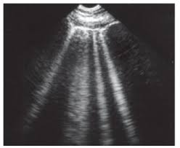
Pulmonary Edema

Slide 52
Pulmonary Edema
Notes:
They are super fast in developing and actually resolve quickly with treatment. Noble study with dialysis patients.
Both lungs with 3 or more B lines is 85% sensitive and 97% specific for alveolar insterstitial syndrome- can be due to pulm edema, PNA, or ARDS.
>3 per rib space is pathologic.

Slide 53
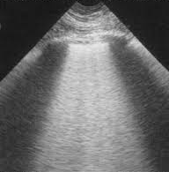
Pulmonary Edema
Notes:
Birroleau variant.

Slide 54
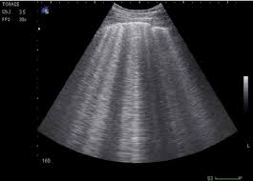
B Lines in Trauma
Notes:
Think pulmonary contusion.

Slide 55
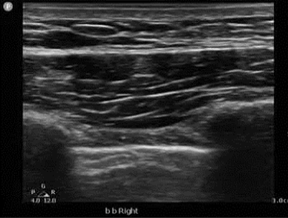
Pneumothorax

Slide 56
Lung Sliding

Slide 57
Lung Sliding

Slide 58
Lung Sliding

Slide 59
Lung Sliding

Slide 60
Loss of Lung Sliding

Slide 62
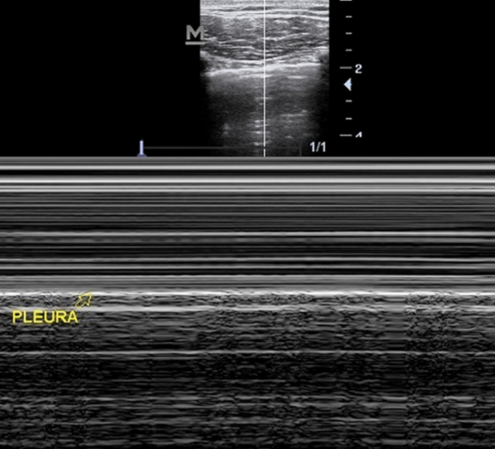
Sandy Beach Sign

Slide 64
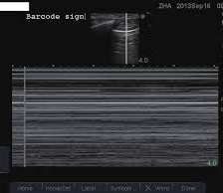
Barcode Sign

Slide 65
Lung Point

Slide 66
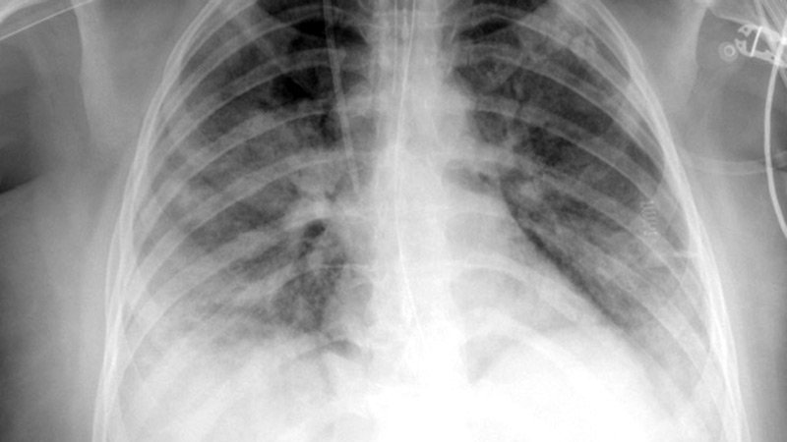
COVID Lungs

Slide 67
