Slide 1
The bleeding patient
Erin Kathleen Espinoza, DO
Hematology/Oncology Fellow
University of Cincinnati Medical Center
April 10th 2020

Slide 2
Learning objectives
How to workup a suspected bleeding disorder
Manage acute bleeding in patients with:
Hemophilia A and B
von Willebrand disease

Slide 3
Case 1
72 yo male with history of CLL s/p chemoimmunotherapy in 2012, presents with right thigh swelling and pain.

Slide 4
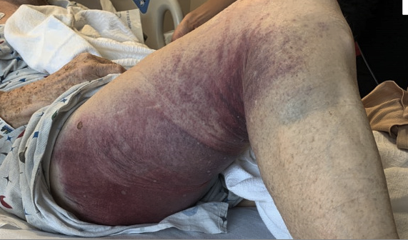

Slide 5
Questions to ask: “bleeding history”
How long does bleeding occur after minor injuries
Does bleeding ever occur spontaneously? Epistaxis
What is the size of bruises? Hematomas?
Bleeding after surgeries? (tooth extractions)
For women: excessive hemorrhage after childbirth? How many tampons/pads to use on heaviest days? Severe IDA?
On blood thinners? Taking NSAIDs, fish oil? Alcohol use/cirrhosis?
Family history? Hemophilia, vWD

Slide 6
Never had issues with bleeding (spontaneous or with wisdom tooth extractions) until about 2 months ago.
Mohs procedure for BCC of cheek with post op hematoma; required electrocautery, but still has some oozing from the site.
Denies trauma to the right thigh.
Only on Aspirin 81mg, which was held 5 days before Mohs surgery. Has not restarted it since.
Reports a large bruise on right thigh that is tender and hard. Denies epistaxis or other mucocutaneous bleeds.

Slide 7
Differentials
Which have the highest mortality that I need to rule out first?
Acute promyelocytic leukemia
DIC (sepsis, APL, pancreatitis, pregnancy)
TTP/HUS
All the others?
ITP
HHT
Vitamin K deficiency (+others)
Hemophilia A and B
Inhibitors
von Willebrand disease
Acquired factor deficiencies

Slide 8
What labs do you want first?
7.7
PT = 11.6 (n)
PTT = 47.9 (high)
INR = 1.2 (n)
130
103
29
42
251
98
4.4
22
2.19
MCV 98, Retics 2.14
Lymph predominant (unchanged)
No blasts ☺
LDH and haptoglobin – normal
Fibrinogen – normal
Peripheral smear – increased # lymphs,
no schistocytes, normocytic/normochromic RBCs,
platelets of normal size and #

Slide 9
What are the causes of prolonged isolated PTT?
Heparin
DOAC can cause mild elevations
Lupus anticoagulant
More likely to cause THROMBOSIS
Factor deficiencies (VIII, IX, XI, XII)
Inherited or acquired
von Willebrand disease
Variable

Slide 10
Coagulation cascade
CLOT

Slide 12
Next step?
You ruled out heparin use and the patient is bleeding not clotting
Factor deficiency or vWD?
Mixing study!
PTT 88.6 → 41.5 (reference range: 25-35)
Factor VIII = undetectable
Bethesda titer (amt of Factor VIII inhibitor
present) = 0.8 (mildly high)

Slide 13
Conclusion?
Elderly man with subacute bleeding history and large spontaneous hematoma with isolated prolonged PTT that CORRECTS on mixing study and severely low Factor VIII level.
Acquired Factor VIII Deficiency!

Slide 14
Acquired Factor VIII deficiency
Autoantibodies against factor VIII
50% of cases are idiopathic
The other half are related to: autoimmune, pregnancy, malignancy
Most patients are elderly males
More hematomas, less likely to see hemarthroses
Spontaneous
Retroperitoneal bleeds
Less so- GI/GU, intracranial bleeds

Slide 15
Treatment
Replace factor 8 for goal FVIII level >80%
Prednisone 1mg/kg
Autoimmune disorder
Rituximab for underlying CLL

Slide 16
If an INHIBITOR is present (high Bethesda titer) you need a “Bypassing agent”
aPCC is the easiest to come by
”FEIBA”- Factor Eight Inhibitor Bypassing Agent
Contains FX, IX, VII, II (vitamin K dependent factors)
rFVIIa – activates the clotting cascade via the EXTRINSIC pathway

Slide 17
Hemophilia and vWD

Slide 18
Hemophilia
X-linked recessive disorder
Deficiency in Factor VIII (hemophilia A) or Factor IX (hemophilia B)
10-20% of female carrier also have hemophilia
Why…?
Classification based on factor level
Mild: 5-49% - bleed with trauma or procedures
Moderate: 1-5% - some spontaneously bleed
Severe: <1% - frequent spontaneously bleed, require prophylaxis

Slide 19
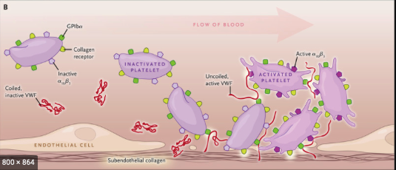
von Willebrand Disease
Most common inherited bleeding disorder (1%)
Type 1 – quantitative deficiency
Mild bleeds, mostly mucosal/epistaxis
Good responders to DDAVP
Type 2 – qualitative deficiencies
Moderately severe bleeds
Type 3 – Complete absence of VWF:Ag
Severe bleeds, hemarthrosis
Image courtesy of NEJM

Slide 20
von Willebrand Disease
Type 1 – quantitative deficiency
Mild bleeds, mostly mucosal/epistaxis
Good responders to DDAVP
Type 2 – qualitative deficiencies
Moderately severe bleeds
Type 3 – Complete absence of VWF:Ag
Severe bleeds, hemarthrosis
Flood. Am Soc Hematol Educ Program. 2015

Slide 21
Important points:
1. Triage quickly, get bleeding history
Exam may be normal
Treat based on the suspicion of a bleed
2. “Factor first!” – everything else later (imaging, sutures, etc.)
Round UP to the nearest vial and give it ALL - $$$$
Allow patient to use home factor if they brought it
3. Don’t hesitate to call hematology, pharmacy, and the best phlebotomist

Slide 22
Bleeding in the Hemophilia A and B patient

Slide 23
General guidelines
Initial starting doses of Factor replacement:
Hemophilia A: 1 U/kg of FVIII increases level by 2%
Hemophilia B: 1 U/kg of FIX increase level by 1%

Slide 24
 | Goal factor level | Hemophilia A FVIII dose (t^{1/2} = 8-12h) | Hemophilia B FIX dose (t^{1/2} = 18-24h) | Duration
Major/severe bleeding | ~100% | 50 units/kg Every 8-12 hours | 100 units/kg Every 12-24 hours | Until bleeding stops + 14 days
Hemarthrosis | ~60% | 25 units/kg Every 8-12 hours | 50 units/kg Every 12-24 hours | 3-5 days Inpatient or outpatient
Minor bleeds | ~50% | 25 units/kg Every 12 hours | 50 units/kg Every 24 hours | 1-3 days Outpatient

Slide 25
Hemarthrosis
The most common bleeding events you will see
Aura = “tingling sensation” and tightness in the joint
Bleeding history
Factor replacement
RICE rules
Pain control – acetaminophen, opiates, COX-2 inhibitors, NO NSAIDs
4. Everything else later
Most do not need imaging

Slide 26
Intramuscular bleeds
Always be wary of compartment syndrome!
Iliopsoas hemorrhage
High morbidity
Thigh, hip, abdomen, groin pain
7-14 days STRICT inpatient bed rest
Serially CBCs and imaging
Complications: Hip flexion contracture or femoral nerve paresthesia
Image courtesy of: Raediopedia.org

Slide 27
Bleeding in the von Willebrand Disease patient
NIH.gov. The Diagnosis, Evaluation and Management of von Willebrand Disease: Full Report

Slide 28
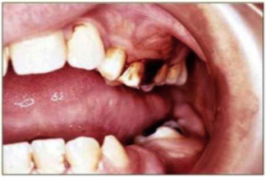
von Willebrand Disease
DDAVP (desmopressin) – need to have a documented response
Antifibrinolytics (TXA, EACA) – mouthwash
3. Replacement therapies
Plasma derived concentrates (Humate-P®, Alphanate®, Wilate®)
Caution – accumulation of FVIII (>200%) → risk of thrombosis
Recombinant (Vonvendi®)
No FVIII in product

Slide 29
The bleeding patient requires a multidisciplinary approach

Slide 30
Take home points
1. The right questions can help in your diagnosis
2. Understand the basics of the coagulation cascade to workup a bleeding patient and interpret lab values
3. Mixing studies
If it corrects → factor deficiency → check factor levels
Treat with factor replacement
If it doesn’t correct → inhibitor present → order Bethesda titer
Treat with a bypassing agent (aPCC, rFVIIa)
4. for Hemophilia and vWD bleeders

Slide 31
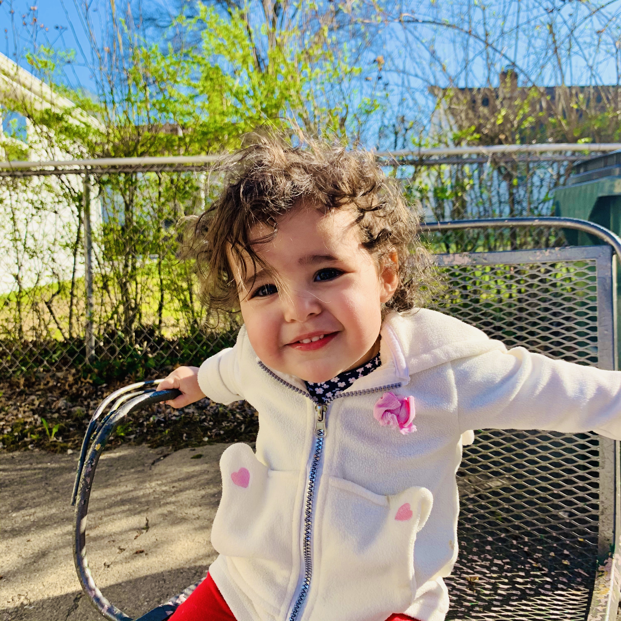
THANK YOU!
QUESTIONS?

Slide 32
HOMEWORK!
Use the next slides to test your knowledge on the coagulation cascade. Once you understand the basics… everything falls else into place ☺
Also, don’t beat yourself up- even us heme fellows struggle.

Slide 33
Causes of an isolated prolonged PT?

Slide 35
Causes of isolated prolonged PT?
Warfarin, DOACs
Factor VII deficiency
Liver disease
Mild DIC

Slide 36
Causes of prolonged PT and PTT?
Deficiencies of common pathway (factor X, factor V, prothrombin, fibrinogen) – acquired or inherited
Liver disease
DIC
Vitamin K deficiency
Too much or multiple anticoagulants (heparin + warfarin)
Combined factor deficiencies (rare)
Factor X deficiency 2/2 amyloidosis (rare)

Slide 37
What labs help me tease out the difference between coagulopathy of liver disease, DIC, & vitamin K deficiency? Or the combination of these?!?
Things to remember:
Factor VIII is mostly made in endothelium.
Factor VIII is an acute phase reactant
Factor V and VII are made in the liver
Factor VII is vitamin K dependent
Fibrinogen is an acute phase reactant
The coagulation cascade ;)

Slide 38
Vitamin K deficiency
Normal Factor V
↓ Factor VII (vitamin K dependent!)… so only PT is prolonged
Normal Factor VIII
Normal fibrinogen

Slide 39
Liver disease
↓ Factor V
↓ Factor VII
Normal/↑ Factor VIII
Prolonged PT (because ↓ FV and VII)
Normal/prolonged PTT
Variable fibrinogen

Slide 40
DIC
↓ Factor V
Normal Factor VII
↓/normal Factor VIII
↓/normal Fibrinogen
**very sick patient with normal FVIII and/or fibrinogen is NOT normal because it’s an acute phase reactant
Prolonged PT (due to low FV)
Normal/prolonged PTT

Slide 41
Liver disease + DIC
↓↓ Factor V
↓ Factor VII
↓/normal Factor VIII
Prolonged PT and PTT
↓Fibrinogen

Slide 42
Liver disease + Vitamin K deficiency
↓ Factor V
↓ Factor VII
Normal Factor VIII
Prolonged PT and PTT
↓/normal Fibrinogen

